Slide 1




React
Prepared by: Aamir Pinger
fb.com/AamirPingerOfficial
linkedin.com/in/AamirPinger
github.com/AamirPinger

Slide 2
React Book
https://softchris.github.io/books/react/

Slide 3
React
The initial React release was 2013 by Facebook.
React is a library made over javascript
In recent years single page applications (SPA) have become popular.
React is not an SPA framework but a “view” library.
It is the V in the MVC (Model-View-Controller architectural pattern).

Slide 4
React
Model-View-Controller (MVC) is an application model comprised of three dependent layers.
The model (data)
The view (user interface)
The controller (processes that handle input).
React only enables you to render components as viewable elements in a browser.

Slide 5
React
A Single Page Application (SPA) differs from a normal web application
In SPA that you remain on the same URL and thereby the same page, hence the name.
Traditionally in HTML we create multiple HTML files for multiple page website
In SPA we create one HTML page and create Routes on them to show different pages

Slide 6
Why React

Slide 7
Why React
Because of :
Its compositional model
Its declarative rather than imperative
Unidirectional Data flow/binding
React is simply javascript

Slide 8
Compositional Model

Slide 9
Compositional model
Composition is an act or mechanism to combine simple functions to build more complicated ones.
Why Composition?
Two things to remember:
Simple functions
Combination of simple functions to make another function

Slide 10
Compositional model
Let's look at an a simple JS function example:
function getTwitterProfile (username) {
return 'https://twitter.com/' + username
}
It’s a very simple function

Slide 11
Compositional model
Similarly, the simple getTwitterUserPic function to return url for user twitter profile picture:
function getTwitterUserDP (username) {
return ‘https://avatars.io/twitter/’ + username + ‘/medium'
}
Another very simple function

Slide 12
Compositional model
Let’s combine both functions
function getTwitterProfileData (username) {
return {
twitterProfile: getTwitterProfile(username),
profilePic: getTwitterUserDP(username)
}
}
That is composition!

Slide 13
QUESTION ARISES?
Why three function instead of one directly?

Slide 14
Compositional model
What we did
function getTwitterProfile (username) {
return 'https://twitter.com ' + username
}
Function 1
Function 2
function getTwitterUserDP (username) {
return ‘https://avatars.io/twitter/’ + username + ‘/medium'
}
Composite Function
function getTwitterProfileData (username) {
return {
twitterProfile: getTwitterProfile(username),
profilePic: getTwitterUserDP(username)
}
}

Slide 15
Compositional model
How about
function getTwitterProfileData (username) {
return {
twitterProfile: 'https://twitter.com ' + username,
profilePic: ‘https://avatars.io/twitter/’ + username + ‘/medium'
}
}
Non composite way
Composite Function
function getTwitterProfileData (username) {
return {
twitterProfile: getTwitterProfile(username),
profilePic: getTwitterUserDP(username)
}
}

Slide 16
Compositional model
How about
function getTwitterProfileData (username) {
return {
twitterProfile: 'https://twitter.com ' + username,
profilePic: ‘https://avatars.io/twitter/’ + username + ‘/medium'
}
}
Non composite way
Two separate functions with one composite function is better as it increase reusability.
There is always a one rule for a good function, a rule of "DOT", Do one thing!

Slide 17
React & Composition
In React we rely on composition, heavily!
In React we create Components to build different sections of a website
Components are building blocks in React.
For example following are three different components:
<LandingPage />
<AboutUs />
<ContactUs />
Currently they are independent component

Slide 18
React & Composition
In React, we can have a composite component as simple as
<LandingPage>
<AboutUs />
<ContactUs />
</LandingPage>
<LandingPage> become parent component and other become child component
This way we can use individual component blocks to build a big website.

Slide 19
Declarative Nature

Slide 20
Declarative nature
Most of JavaScript is imperative code.
We spoon feed each and every step to make javascript aware of how to get desired result.
Let’s take a example water tank level
Manual - (Imperative)
Auto - (Declarative)

Slide 21
Declarative nature
Imperative code!
const teachers = ['Zia', 'Irfan', 'Muneeb', 'Aamir']
const titles = [] for (let i = 0; i < teachers.length; i++) { titles[i] = 'Mr. ' + teachers[i] }
console.log(titles)
RESULT: ['Mr. Zia', 'Mr. Irfan', 'Mr. Muneeb', 'Mr. Aamir']

Slide 22
Declarative nature
Declarative code!
const teachers = ['Zia', 'Irfan', 'Muneeb', 'Aamir']
const titles = teachers.map( name => 'Mr. ' + name )
console.log(titles)
RESULT: ['Mr. Zia', 'Mr. Irfan', 'Mr. Muneeb', 'Mr. Aamir']

Slide 23
React - Declarative Nature
In React we will soon going to see declarative code like following
<PrintOnBrowser name=’Aamir’ />
<PrintOnBrowser name=’Aamir Pinger’ />
RESULT on Browser:
Aamir
Aamir Pinger

Slide 24
Unidirectional
Data Binding

Slide 25
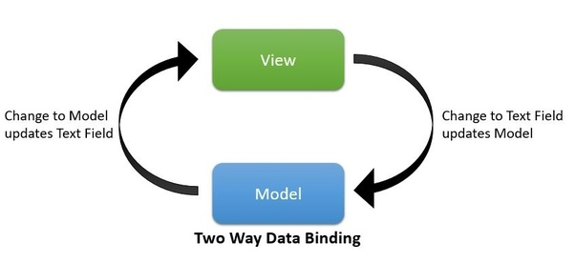
Two way data binding
Many front-end framework like Angular uses two way data binding.
Two-way data binding look really great, but when application grows it is hard to determine where the data is actually being updated.

Slide 26
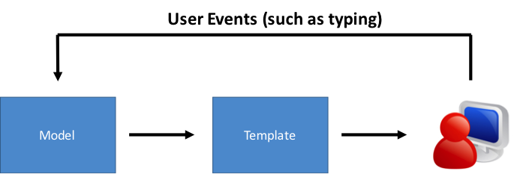
Unidirectional Data Binding
One-way data binding only propagates changes from the model to the UI, not vice versa.
It is known as “single source of truth”.
Source: https://www.accelebrate.com/blog/two-way-data-binding-angular-2-and-React/

Slide 27
React is simply Javascript

Slide 28
React is simply Javascript
Uptil now we haven’t seen any code other then javascript code
React is small library based on Javascript
Even components in React are JavaScript class or function
Arrow functions, .map() and .filter() will be seen used extensively in any React code

Slide 29
DOM vs Virtual DOM

Slide 30

DOM
DOM is Document Object Model
It’s a programming interface for HTML and XML documents
When a web page is loaded, the browser creates a Document Object Model of the page.
DOM Tree
https://www.w3schools.com/js/js_htmldom.asp

Slide 31
DOM
The DOM is an object-oriented representation of the web page.
Scripting language such as JavaScript can modify the document structure, style, and content.
DOM Tree
https://www.w3schools.com/js/js_htmldom.asp

Slide 32
Virtual DOM
React introduced Virtual DOM (VDOM)
The VDOM is a programming concept where a virtual representation of a UI is kept in memory
It’s is a tree based on JavaScript objects created with React that resembles a DOM tree
A process called Reconciliation is used to sync Real DOM with VDOM
React uses ReactDOM Library updates VDOM and render it on actual DOM

Slide 33
QUESTION ARISES?
Why Virtual DOM is needed?

Slide 34
Why Virtual DOM is needed?
Making changes in memory (VDOM) is quite faster than updating a complete browser screen (Real DOM)
React creates first VDOM when application launches and then put everything on browser

Slide 35
Why Virtual DOM is needed?
Once app need to update browser screen, React creates new updated VDOM
Through reconciliation process React find out difference between new and old VDOM
Lastly only updates the difference to browser (Real DOM)

Slide 36
JSX

Slide 37
JSX
JSX stands for JavaScript XML.
Browser uses HTML tags to render the content of the webpage
.html files are used to write HTML tags
React is javascript and it uses .js files.
JSX allows us to write HTML tags in .js files.
JSX makes it easier to write and add HTML in React.

Slide 38
JSX Example
In HTML we write
<div> Hello world </div>
In React
React.createElement(‘div’, null, ‘Hello World’)

Slide 39
JSX Example
In HTML we write
<div>
<h1> Hello world <h1>
</div>
In React
React.createElement(
‘div’,
null,
React.createElement(h1’, null, ‘Hello World’)
)

Slide 40
JSX
For nested tags React gives us easy way to write, for example
In HTML
<div>
<h1>Some title</h1>
<div>Some content</div>
</div>
In React
var myElement = (
<div>
<h1>Some title</h1>
<div>Some content</div>
</div>
)
ReactDOM.render(<myElement />,
document.getElementById('root’)
)

Slide 41
JSX
Important thing to remember, JSX needs to have one parent.
This will throw error
var myElement = (
<h1>Some title</h1>
<div>Some content</div>
)
ReactDOM.render(<myElement />,
document.getElementById('root)
)
var myElement = (
<div>
<h1>Some title</h1>
<div>Some content</div>
</div>
)
ReactDOM.render(<myElement />,
document.getElementById('root)
)

Slide 42
JSX
We can also use React.Fragment instead of <div>
var myElement = (
<React.Fragment>
<h1>Some title</h1>
<div>Some content</div>
</React.Fragment>
)
ReactDOM.render(<myElement />, document.getElementById('root))
Better way

Slide 43
Setting up React

Slide 44
Setting up React
Easiest way to setup React environment is by using create-react-app
Create-react-app scaffold a basic React application with ease and will get you up and running in no time.
To install create-react-app
aamir@ap-linux:~$ npm install create-react-app -g

Slide 45
Setting up React
To scaffold React application
aamir@ap-linux:~$ npx create-react-app my-app
aamir@ap-linux:~$ cd my-app
aamir@ap-linux:~/my-app$ npm start
http://localhost:3000

Slide 46
Our first React component

Slide 47
Our first React component
There few types of component from which we will be working with following two type in this course
Class based Component
Function based Component

Slide 48
Class based Component
class MyComponent extends React.Component {
render() {
return (
<div>
<h1> Hello world </h1>
</div>
)
}
}
ReactDOM.render(
<MyComponent />,
document.getElementById(‘root’)
)

Slide 49
Functional based Component
function MyComponent () {
return (
<div>
<h1> Hello world </h1>
</div>
)
}
ReactDOM.render(
<MyComponent />,
document.getElementById(‘root’)
)

Slide 50
Create-react-app generated files

Slide 51
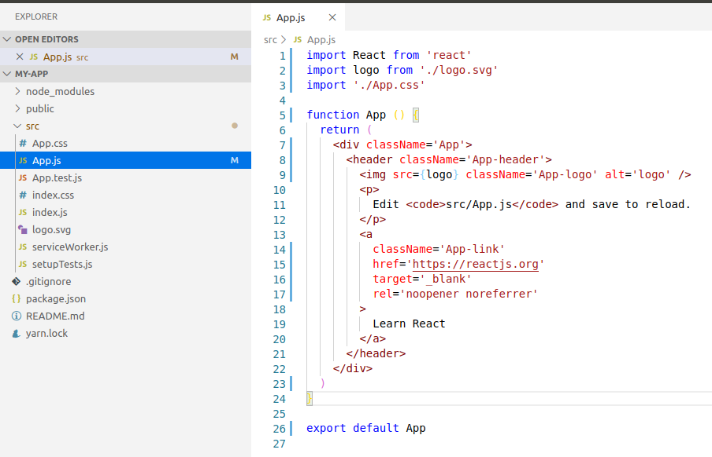
Directory and files after create-react-app

Slide 52
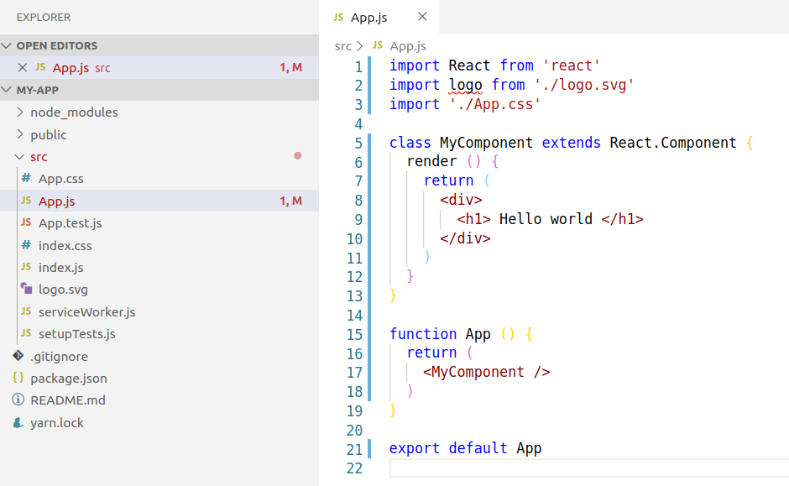
Our first React component
https://github.com/aamirpinger/react-fundamental-slides-code/blob/master/myFirstComponent.js

Slide 53
Component with .map method
import React from 'react'
class MyComponent extends React.Component {
render () {
const cityArray = ['Karachi', 'Lahore', 'Peshawar', 'Quetta']
return (
<ul>
{
cityArray.map(city => <li key={city}> {city} </li>)
}
</ul>
)
}
}
function App () {
return (<MyComponent />)
}
export default App
ComponentWithDotMap.js
Result
Karachi
Lahore
Peshawar
Quetta

Slide 54
Component with .filter method
import React from 'react'
class MyComponent extends React.Component {
render () {
const cityArray = ['Karachi', 'Lahore', 'Peshawar', 'Quetta']
const shortListedCities = cityArray.filter(city => city.length > 6)
return (
<ul>
{
shortListedCities.map(city => <li key={city}> {city} </li>)
}
</ul>
)
}
}
function App () {
return (<MyComponent />)
}
export default App
ComponentWithDotFilter.js
Result
Karachi
Peshawar

Slide 55
Component Reusability

Slide 56
Component Reusability
import React from 'react'
class MyComponent extends React.Component {
render () {
const cityArray = ['Karachi', 'Lahore', 'Peshawar', 'Quetta']
const shortListedCities = cityArray.filter(city => city.length > 6)
return (
<ul>
{ shortListedCities.map(city => <li key={city}> {city} </li>)}
</ul>
)}
}
function App () {
return (
<div>
<MyComponent />
<MyComponent />
</div>
)}
export default App
ComponentWithDotFilter.js
Result
Karachi
Peshawar
Karachi
Peshawar

Slide 57
props

Slide 58
props
React allow us to send data or functions from parent component to it’s child component
These data or functions are called props
Adding props, or properties to your component means we add attributes to our component element.

Slide 59
props
Component call WITHOUT props
<myElement />
Component call WITH props
<myElement
name=’Aamir’
myfunc={() => console.log(‘hello world’)}
/>

Slide 60
props
This means we can pass data from an outer component to an inner component.
That data can be either data that we want to render a or a function that we want to invoke.

Slide 61
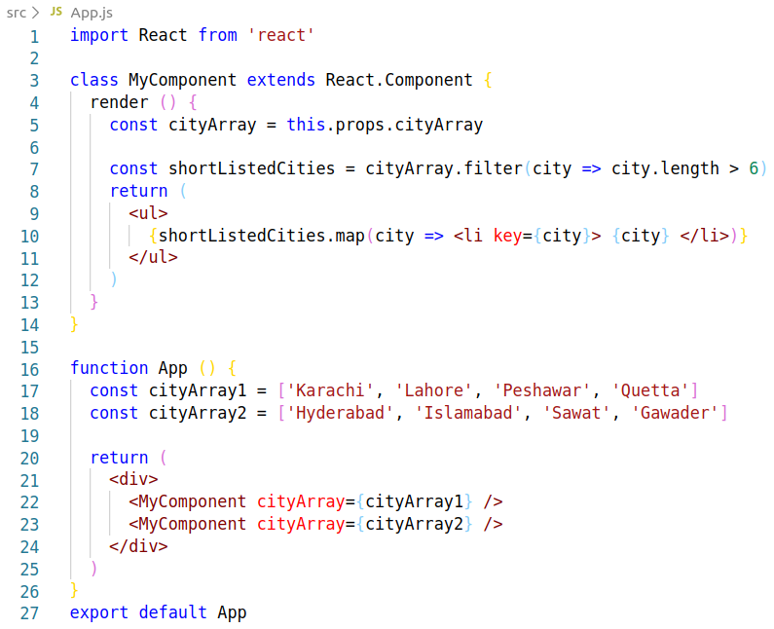
props
PassingProps.js
Result
Karachi
Peshawar
Hyderabad
Islamabad
Gawader

Slide 62
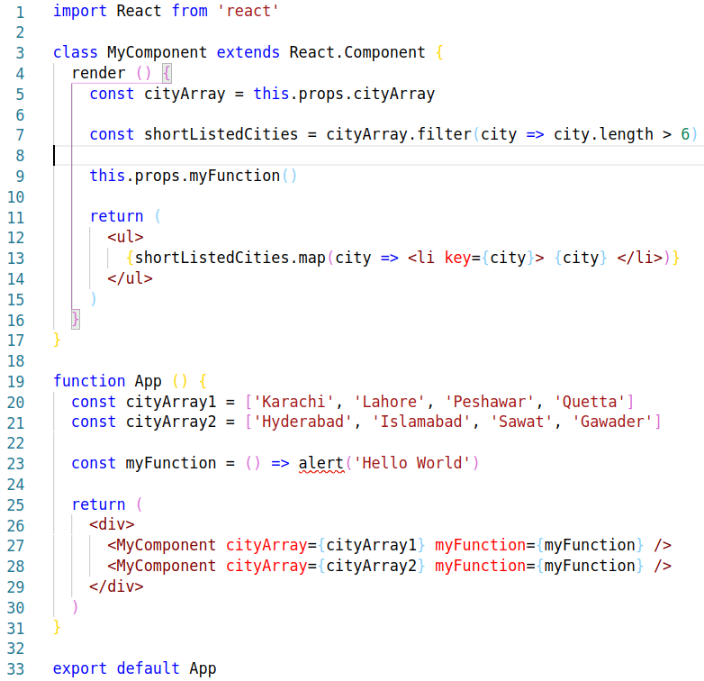
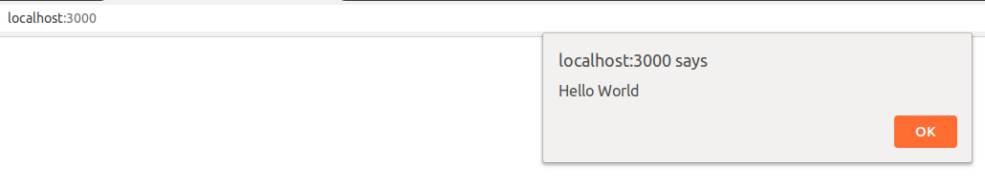
props
PassingPropsAndFunction.js
Result

Slide 63
Passing Props to
Functional component

Slide 64
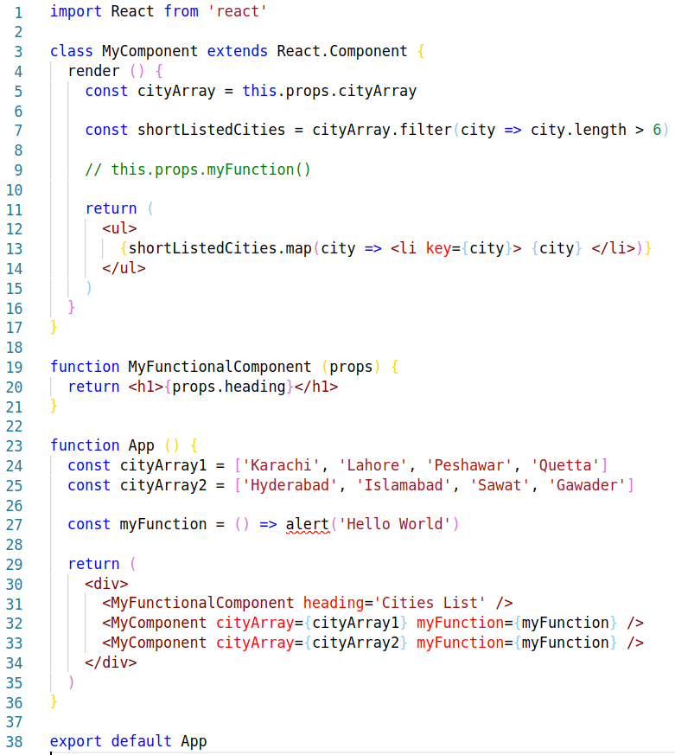
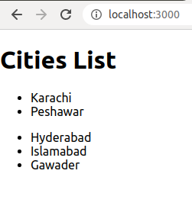
Props to Functional Component
PropsToFunctionalComp.js
Result

Slide 65
PropTypes

Slide 66
PropTypes
React components are meant to be reuse
In a bigger application soon teams will work on a project and reuse other’s components
Props is integral part of component

Slide 67
QUESTION ARISES?
What if wrong props are passed to our component
e.g. array instead of object

Slide 68
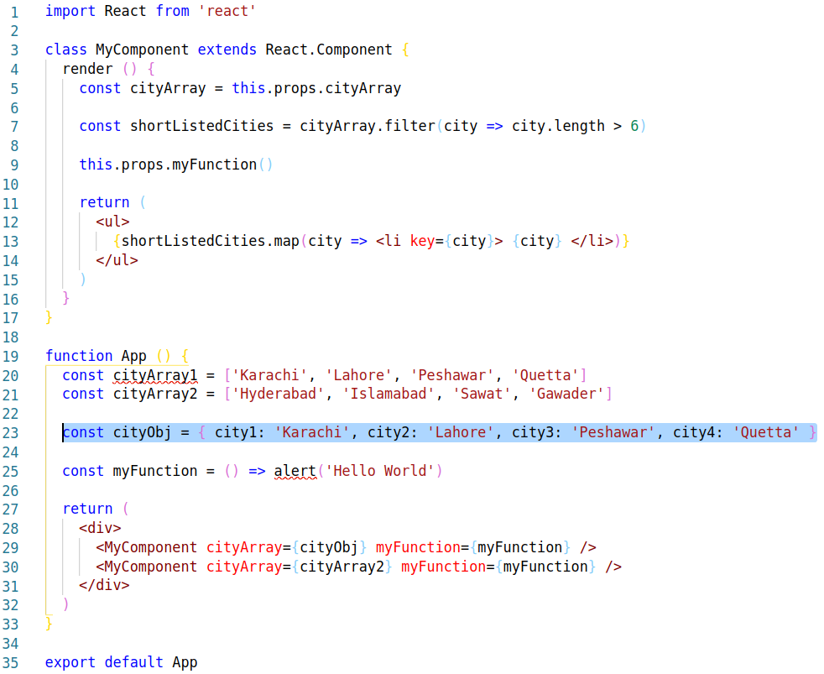
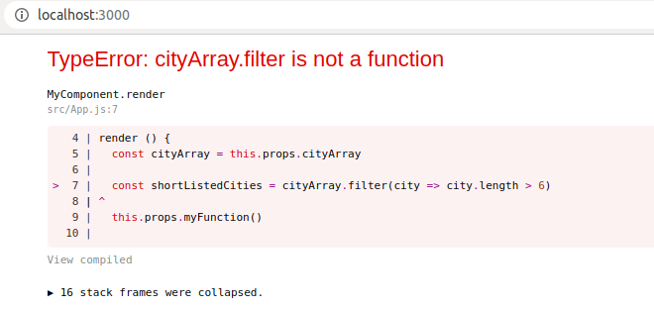
Wrong props
Result

Slide 69
PropTypes
By using PropTypes library, we can define the data type we expect if someone uses our component and passes props to it.
It will warns us during development in the console of browser if unexpected data type passed
To install PropTypes
aamir@ap-linux:~$ npm install prop-types
More details: https://github.com/facebook/prop-types

Slide 70
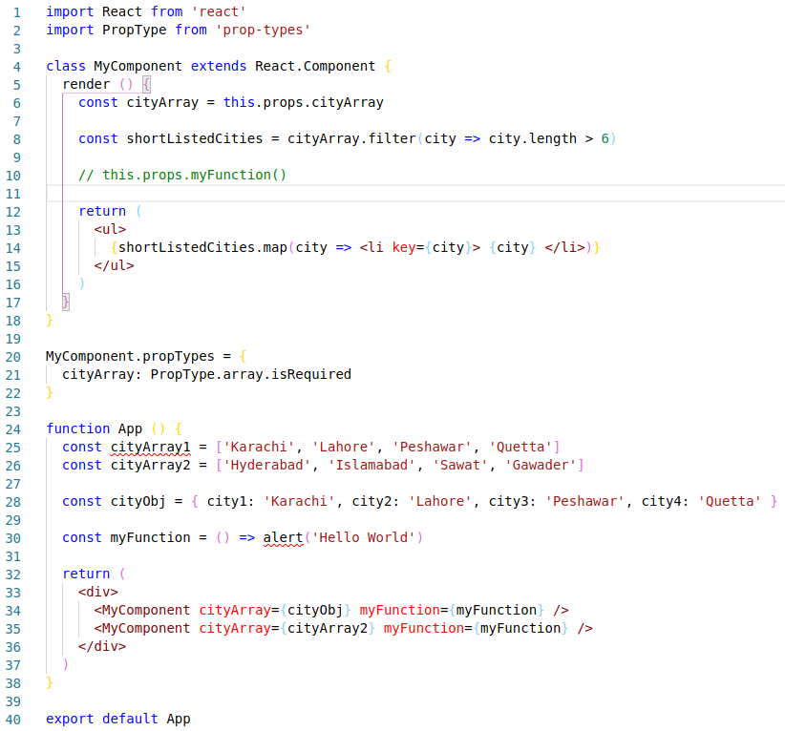
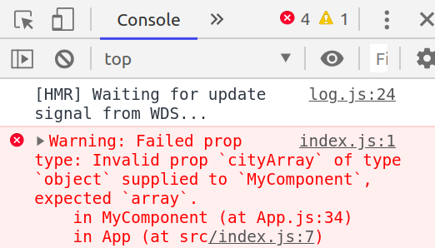
PropTypes
PropTypeExample.js
Result

Slide 71
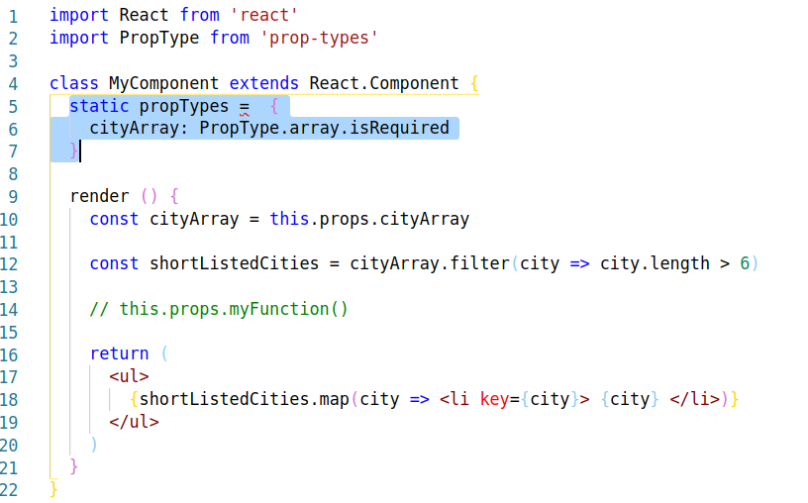
PropTypes
PropTypeInClass.js
It is considered a best practice to always use this library
It is also recommended to make it part of the class

Slide 72
State

Slide 73
State
The heart of every React component is its “state”
It is simply an Javascript object that determines how that component renders & behaves
In other words, “state” is what allows you to create components that are dynamic and interactive

Slide 74
State
Props from parent component are immutable
State is mutable
Change in state re-renders your component at browser
Every change in state provide updated data to the user

Slide 75
State
By rules State can only be declared for class components
That’s what makes you decide whether to use class component or functional component
By using React Hooks you can now have React state in the functional component

Slide 76
Place to declare State

Slide 77
Where state should be declared
State can only be mutate by owner component
You can make one parent component with state and pass the state value to its child components as a props
Props cannot change they are immutable
If child component need to make any changes in state it can request its parent (owner) component to make changes

Slide 78
Where state should be declared
Parent component has to pass a function as a props which will be used by child component to request a state change
Once changes are done by parent, react automatically pass updated state value to all the child component where parent component have passed state values as a props
This way React insures single source of truth and unidirectional data model

Slide 79
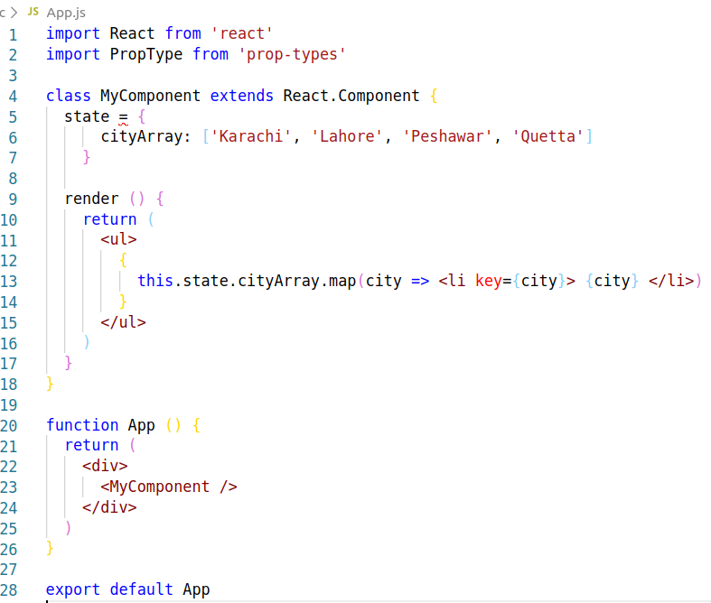
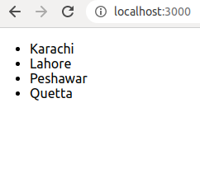
State
StateExample.js
Result

Slide 80
Destructuring

Slide 81
Destructuring - Array
The destructuring assignment syntax is a JavaScript expression that makes it possible to unpack values from arrays, or properties from objects, into distinct variables
RESULT
Aamir
Pinger
2
Aamir Pinger has 2 Masters degrees.
let myArray = ["Aamir","Pinger",2]
let [firstName, lastName, degrees] = myArray
console.log(firstName)
console.log(lastName)
console.log(degrees)
let sentence = `${firstName} ${lastName} has ${degrees} Masters degrees.`
console.log(sentence)
DestructuringArray1.js

Slide 82
Destructuring - Array
RESULT
Aamir
Pinger
degrees is not defined
let myArray = ["Aamir","Pinger",2]
let [firstName, lastName] = myArray
console.log(firstName)
console.log(lastName)
console.log(degrees)
let sentence = `${firstName} ${lastName} has ${degrees} Masters degrees.`
console.log(sentence)
DestructuringArray2.js

Slide 83
Destructuring - Object
let myObject = {firstName: "Aamir", lastName: "Pinger", degrees: 2}
console.log(myObject.firstName)
console.log(myObject.lastName)
console.log(myObject.degrees)
let {firstName, lastName, degrees} = myObject
console.log(firstName)
console.log(lastName)
console.log(degrees)
let sentence = `${firstName} ${lastName} has ${degrees} Masters degrees`
console.log(sentence)
RESULT
Aamir
Pinger
2
Aamir
Pinger
2
Aamir Pinger has 2 Masters degrees.

Slide 84
Destructuring - Object
let myObject = {firstName: "Aamir", lastName: "Pinger", degrees: 2}
console.log(myObject.firstName)
console.log(myObject.lastName)
console.log(myObject.degrees)
let {firstName, lastName} = myObject
console.log(firstName)
console.log(lastName)
console.log(degrees)
let sentence = `${firstName} ${lastName} has ${degrees} Masters degrees`
console.log(sentence)
RESULT
Aamir
Pinger
2
Aamir
Pinger
degrees is not defined

Slide 85
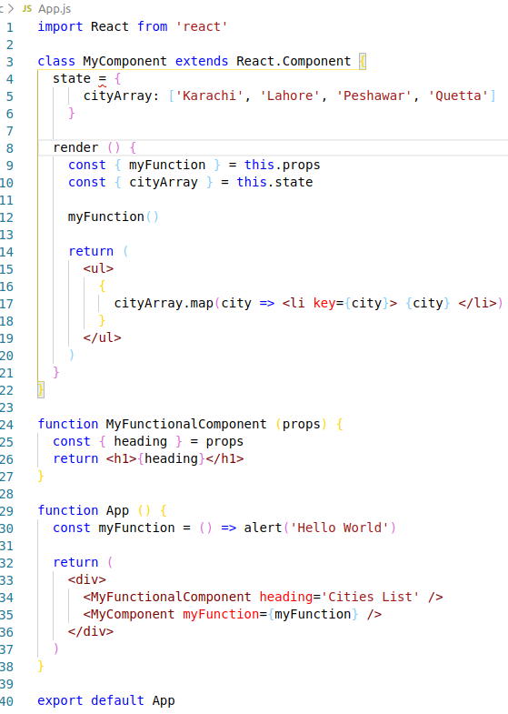
Destructure State and Props
DestructureStateAndProps.js

Slide 86
Changing State

Slide 87
Changing State
To change state we use setState method
Beauty of setState method is no matter if your state got many key value pairs, you can just pass specific keys and their new values you want to update
Once setState method updates the state it rerenders that component and your browser gets updated data

Slide 88
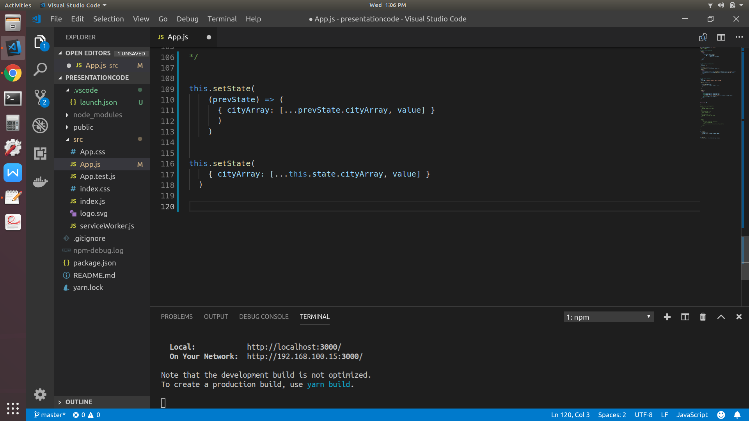
setState Method
setState function in React is an asynchronous function
There are two variations of using setState:
Object-based approach
Functional approach
OBJECT-BASED APPROACH
FUNCTIONAL APPROACH

Slide 89
setState Method
Add city name example Code:
AddCityInState.js
Remove city name example Code:
RemoveCityFromState.js

Slide 90
Forms

Slide 91
Forms
Form is not new in react, it is same as we used in HTML
Form is helpful to group multiple input fields and validate on submit
These input fields can be any of the HTML input field types. Examples are:
Textbox
Checkbox
Radio
TextArea
Date input
Select

Slide 92
Form Example
Form example Code:
FormExample.js

Slide 93
Conditional rendering

Slide 94
Conditional rendering
Conditional rendering is about deciding what to render and when
It is simply rendering something if provided condition is matched
For example:
Maximum limit message component
Render an error message instead of alert in case of no city name provided on submit

Slide 95
Conditional rendering
There are different approaches we can have here:
render if true
ternary expression
Short circuit evaluation

Slide 96
Conditional rendering Example
Conditional rendering example Code:
ConditionalRendering.js

Slide 97
Styling

Slide 98
Styling
Styling is also a important aspect to look when developing a web app
No matter how efficient you have made you web app, if you did not made good UI/UX, user may not use it
React provide us multiple ways to use styling
Some of the widely used practices are
CSS files
Inline Styling
3rd party libraries like Styled Components

Slide 99
Styling with CSS files

Slide 100
Styling with CSS files
CSS styling example Code:
CSS-Styling/

Slide 101
Inline Styling

Slide 102
Inline Styling
Inline styling example Code:
InlineStyling.js
List of all supported HTML attributes that can be passed along to the React element
https://facebook.github.io/react/docs/dom-elements.html#all-supported-html-attributes

Slide 103
Styled Component

Slide 104
Styled Component
CSS files have few issues like these are global in scope
Similar class name could cause side effects to other part of website
Inline styling though not recommended to use but it is sometimes required to make small dynamic styling
Styled components is a library that give us solution for above all
Using style components you don’t need css files, you create styled HTML element in JS files and use them wherever you need them

Slide 105
Styled Component
Styled Component example Code:
CSS-Styling/styled-component-example.js
To install styled-components
aamir@ap-linux:~$ npm install styled-components

Slide 106
Images in React

Slide 107
Images
Rendering images in a react is little different
In HTML you write
<img src="smiley.gif" alt="Smiley face" height="42" width="42">
In React you have to import a file right in a JavaScript module
This tells webpack to include that file in the bundle. During the project star
img tag example Code:
CSS-Styling/imgTagExample.js

Slide 108
Lifecycle Events

Slide 109
Lifecycle Events
When developing in React, every Component follows a cycle from
When it’s created and Mounted on the DOM
Got updated during its presence on DOM
To when it is unmounted from DOM and destroyed
This is what we refer to as the Component lifecycle

Slide 110
Lifecycle Events
The React component which extends React.Component goes through the following phases:
Mounting
Updating
Unmounting
React offer us various methods which are invoked at different phases of the lifecycle of a component.

Slide 111
Lifecycle Events
Mounting phase is initialization of the component when the instance of the component is being created and inserted into the DOM
Updating phase comes when component is re-rendered due to change in props or state etc
Unmounting phase is when unmounting or removal of component from the DOM

Slide 112
Why lifecycle events?

Slide 113
Why lifecycle events?
Render method should be pure and should not have any side effects
Pure method means you get the same output every time when provided same input.
Component’s render() function should be pure, meaning that it does not modify component state

Slide 114
Why lifecycle events?
render() Is meant for Rendering, Only!
As we said its pure and should return same result when provided same input so that means should not make
Any HTTP requests
Fetch data that's used to display the content
Modify the DOM
Or call any function that does the above 3

Slide 115
Lifecycle Events
There are special methods bound to the particular component INSTANCE
Those method triggered on some certain time during component lifecycle
We can use those methods to do thing which we don’t do in render()

Slide 116
Lifecycle Events
React offer us various methods which are invoked at different phases of the lifecycle of a component.
Mounting
constructor()
static getDerivedStateFromProps()
render()
componentDidMount()
Updating
static getDerivedStateFromProps()
shouldComponentUpdate()
render()
getSnapshotBeforeUpdate()
componentDidUpdate()
Unmounting
componentWillUnmount()

Slide 117
constructor()

Slide 118
constructor()
Constructors are not react specific or even javascript specific
They are specific to the inheritance in OOP
When the component class is created in memory, the constructor is the first method called, so it’s the right place to initialize everything – state included
Earlier we need to define constructor method explicitly but babel now transpile state directly without writing it in constructor()

Slide 119
constructor()
class App extends Component {
constructor (props) {
super(props)
this.state = {
firstName: 'Aamir'
}
this.printMessage = this.printMessage.bind(this)
}
printMessage () {
return <h1>{`${this.state.firstName} ${this.props.message}`}</h1>
}
render () {
return this.printMessage()
}
}
export default App

Slide 120
constructor()
class App extends Component {
state = {
firstName: 'Aamir'
}
printMessage () {
return <h1>{`${this.state.firstName} ${this.props.message}`}</h1>
}
render () {
return this.printMessage()
}
}
export default App

Slide 121
componentDidMount()

Slide 122
componentDidMount()
componentDidMount() is invoked only ONCE immediately after a component is mounted (users will have a display on there browsers)
If you need to load data from a remote endpoint (API Calls), this is a good place
Initializing state also should be done here
Setting state in this method will trigger a re-render to update the data everywhere

Slide 123
componentDidMount()
componentDidMount() example Code:
componentDidMountExample.js

Slide 124
static getDerivedStateFromProps()

Slide 125
static getDerivedStateFromProps()
Invoked right before calling the render method, both on the initial mount and on subsequent updates
It should return an object to update the state, or null to update nothing.
This method exists for rare use cases where the state depends on changes in props over time

Slide 126
static getDerivedStateFromProps()
getDerivedStateFromProps() example Code:
getDerivedStateFromPropsExample.js

Slide 127
shouldComponentUpdate()

Slide 128
shouldComponentUpdate()
It returns true by default.
Whenever a component's state or props (its parent's state) is updated, the component re-renders we can stop updating the state if we want
This method is not called for the initial render or when forceUpdate() is used
shouldComponentUpdate() allows us to say: only update if the props you care about change

Slide 129
shouldComponentUpdate()
shouldComponentUpdate() example Code:
shouldComponentUpdateExample.js

Slide 130
componentDidUpdate()

Slide 131
componentDidUpdate()
It is called right after the component update takes place, except the first time when the component is rendered.
componentDidUpdate() takes two arguments as parameters, prevProps and prevState
This method is useful if you want to take any actions on DOM after received updated props from parent or re-render caused by setState
This is also a suitable place when we want to log the new changes

Slide 132
componentDidUpdate()
componentDidUpdate() example Code:
componentDidUpdateExample.js

Slide 133
componentWillUnmount()

Slide 134
componentWillUnmount()
This event (method) is invoked immediately before a component component is being removed from the DOM
Recommended to perform any necessary cleanup in this method, such as
Invalidating timers,
Canceling network requests, or
cleaning up any subscriptions that were created in componentDidMount()

Slide 135
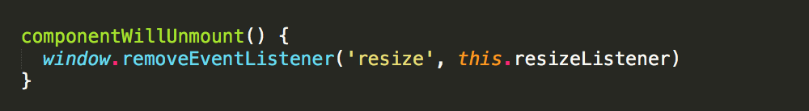
componentWillUnmount()
setState() will not effect if called in componentWillUnmount() because the component cannot re-rendered once unmounted
componentWillUnmount() example:

Slide 136
Components file/directory structure

Slide 137
Components file/directory structure
Uptil now we have made a single App.js file and made all our component into it
This is not at all a good approach
Components should always made in different folders and .js files
Keep app supporting function into utils folder
Keep all images to one static resources folder etc

Slide 138
Components file/directory structure
Component splitted to file/folders example Code:
SampleFolderStructure/

Slide 139
React Router

Slide 140


React Router
User request: index.html
User request: contactus.html
Server response: index.html
Server response: contactus.html
Normal flow of user request on browser and response from server

Slide 141
React Router
Single-page applications can work in different ways
In react we have only index.html
React routers that user move to different pages in your web app without actually changing any page, even URL will show change of page
One way is you can do have conditional rendering and move to different screens (components) on the browser
Above way is not easy to manage and does not give browser back button

Slide 142
React Router
Routing in a Single Page Application is the way to introduce some features to navigating the app through links, which are expected in normal web applications like:
The browser should change the URL when you navigate to a different screen
Deep linking should work: if you point the browser to a URL, the application should reconstruct the same view that was presented when the URL was generated
The browser back (and forward) button should work like expected

Slide 143
React Router
React-router-dom is a library for routing in React SPA
It provides all the previously discussed navigation features to SPA
To install react-router-dom
aamir@ap-linux:~$ npm install react-router-dom

Slide 144
React Router - <BrowserRouter>
React-router-dom library provides <BrowserRouter /> component
The purpose of this component is to listen to URL changes
When URL changes this component will make sure the correct screen (page) of your web app get render on the screen
For React Router to work properly, we must have to wrap our whole app into a BrowserRouter component

Slide 145
<BrowserRouter> - index.js
import React from 'react'
import ReactDOM from 'react-dom'
import './index.css'
import App from './Components/App'
import * as serviceWorker from './serviceWorker'
import { BrowserRouter } from 'react-router-dom'
ReactDOM.render(
<BrowserRouter>
<App />
</BrowserRouter>,
document.getElementById('root')
)

Slide 146
<Route>

Slide 147
<Route>
Our routes will be defined in <Route> element
We specify which path they will match and what component that should respond
Let’s say we want
www.ourDomain.com/ to go to City list page
<Route exact path='/' component={CityList} />
www.ourDomain.com/aboutus to go to About us page
<Route exact path='/aboutus' component={AboutUs} />

Slide 148
<Route>
Let’s say you want to pass a some dynamic value to any route at runtime
You can achieve this by for example
<Route exact path='/cityList/:city' component={CityList} />
For components where we passes props, component attribute will be replaced by render=() => (<your component>)
<Route exact path='/cityList' render={() => (<CityList city={[’Karachi’}]>)} />

Slide 149
React Router
React Router example Code:
RoutesExample/

Slide 150
<switch>

Slide 151
<switch>
We can add something like following to our code
<Route render={() => <AnyComponent /> } />
Only problem with this is it will render with every route no matter what path is provided
To solve this problem we must wrap all above routes with <Switch></Switch>
By doing this we actually are instructing that as URL path matches with path of any route first render that component and then jump out of switch block and do not go and check next routes

Slide 152
React Router
import { Switch } from 'react-router-dom'
<Switch>
<Route exact path="/" component={RandomNumber} />
<Route path="/helloworld" component={Helloworld} />
</Switch>
React Router example Code:
RoutesExample/

Slide 153
Programmatic navigation

Slide 154
Programmatic navigation
In many cases you will be needing a way to programmatically navigate using React Router v4
This can be achieved by using a <Redirect /> component
<Redirect to='/dashboard' />
You can also pass <Redirect to={{
pathname: "/login",
state: {
referrer: this.props.location.pathname,
humanType: "Cat Person",
age: 12,
}
}} />
To access these values this.props.location.state

Slide 155
React Router

Slide 156
React Router

Slide 157
React Router

